Slide 1



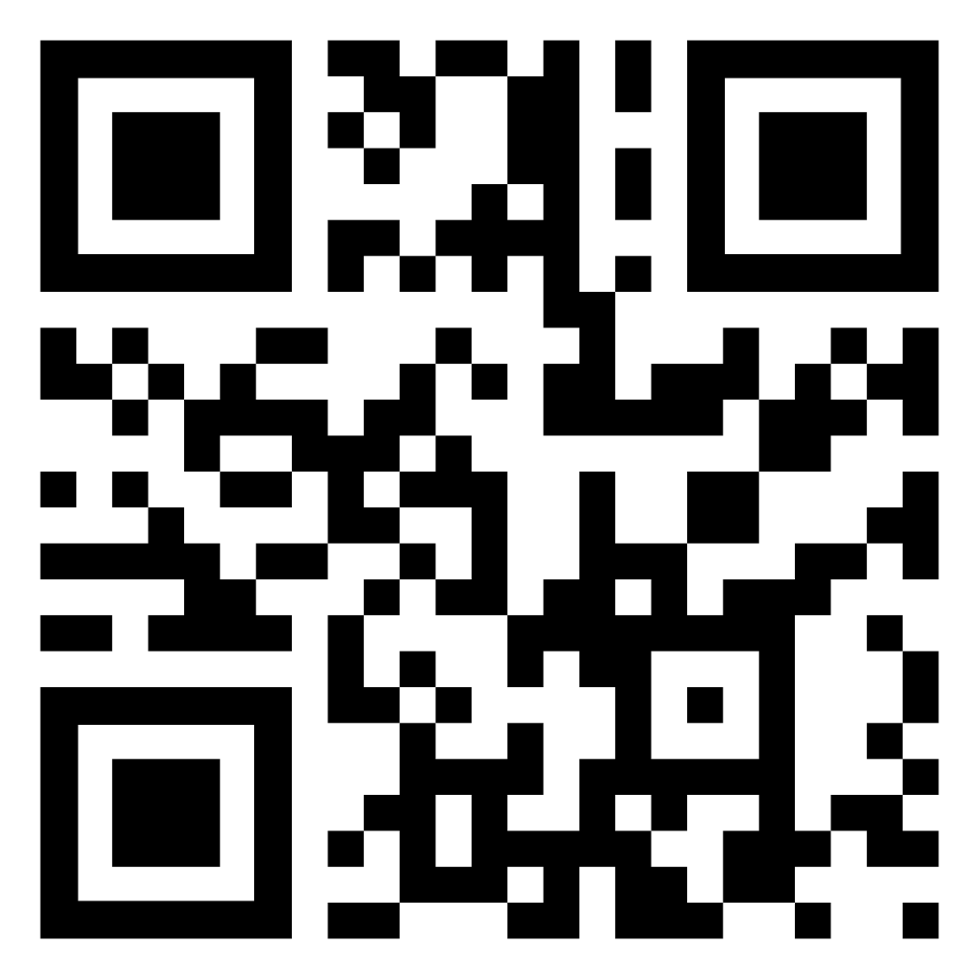
Call for
Abstracts
Opens: August 7, 2026
Submission Deadline: December 7, 2026
Abstract submitters will also be able to apply for Travel Awards, if eligible.
All details will be published on the website: www.ipita2027.org

Slide 2



Important Dates
Friday, August 7, 2026 | Abstract Submission Opens
Monday, December 7, 2026 | Abstract Submission Deadline & Registration Opens
Tuesday, January 7, 2027 | Super Early Bird Deadline
Thursday, February 25, 2027 | Notification Letters to Abstract Presenters
Friday, March 12, 2027 | Early Bird Deadline & Registration Deadline for Presenters
Monday, June 7, 2027 | Standard Registration Deadline & Hotel Cut-Off Date
Friday, June 25, 2027 | Online Registration Closes

